Slide 1


Exploratory Data Analysis
September / 2016
Corporate Presentation Template | © 2016, Abzooba India Infotech Pvt. Ltd.

Slide 2

Overview
Introduction
Motivation
What is Data?
Types of data
Types of attributes
Attribute Metadata
Characteristics of Structured Data
Introduction to Pandas / NumPy
Hands on exploration of a dataset
Univariate Analysis
Bivariate Analysis : Numerical Relations
Bivariate Analysis : Numerical vs Categorical Relations
Multivariate Analysis
Studying Time Trends
Pair wise Collinearity
Resources
Corporate Presentation Template | © 2016, Abzooba India Infotech Pvt. Ltd.

Slide 3
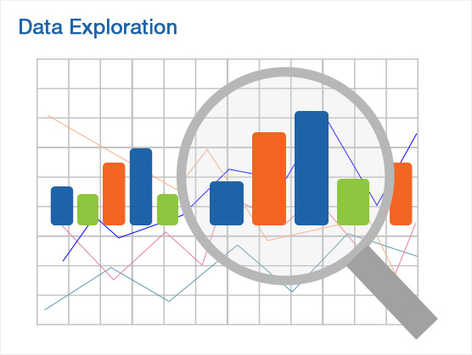
Introduction
“ They say that Data Science is the sexiest job of the 21st Century and rightly so. Data, be it structured or unstructured has power. The goal is to turn data into information, and information into insight that could change the life of a patient, or change the world. ”
Corporate Presentation Template | © 2016, Abzooba India Infotech Pvt. Ltd.

Slide 4
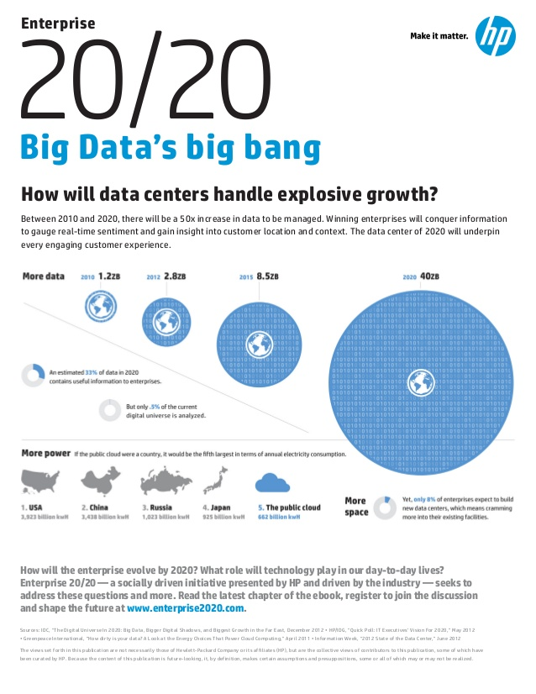
Motivation for Data Science
Back in 2012, the research firm Gartner said there would be a shortage of 100,000 data scientists in the United States by 2020.
In the United States alone, it is reported that by 2018 there will be more than 490,000 data science positions available, but only 200,000 qualified people to fill the roles.
An updated Digital Universe estimate of the amount of data created in the world annually forecast 180 Zettabytes (or 180 trillion gigabytes) in 2025, up from less than 10 Zettabytes in 2015 and 44 Zettabytes in 2020.
Connected devices: From less than 20 billion today to 30 billion in 2020 to 80 billion in 2025; by 2025, there will be 152,200 new connected devices every minute.
Knowledge is truly power, data scientists hold the key to unlocking future business development.
Corporate Presentation Template | © 2016, Abzooba India Infotech Pvt. Ltd.

Slide 5
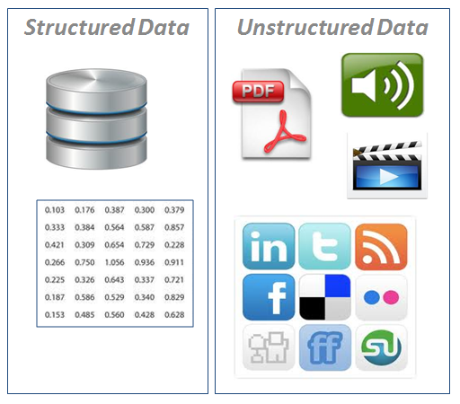
What is Data?
Structured Data
Easy to visualize and model
Data that resides in a fixed field within a record or file
Includes data in a relational database or spreadsheet
Easily stored and analyzed
Data types include numeric, dates, text
Unstructured Data
Difficult to model, all around us
Describes any information that cannot reside in database
Can include emails, presentations, word processing documents, videos, photos, audio files, webpages
Corporate Presentation Template | © 2016, Abzooba India Infotech Pvt. Ltd.

Slide 6
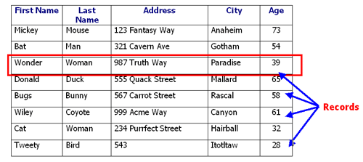
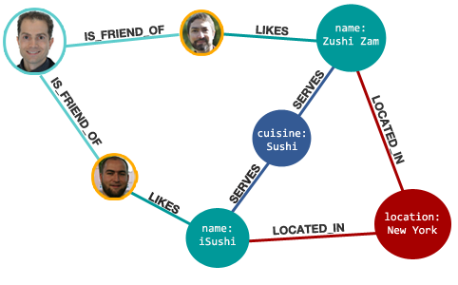
Types of Data
Record
Data Matrix
Document Data
Transaction Data
Graph
World Wide Web
Molecular Structures
Ordered
Spatial Data
Temporal Data
Sequential Data
Genetic Sequence Data
Corporate Presentation Template | © 2016, Abzooba India Infotech Pvt. Ltd.

Slide 7
Types of Attributes
Common types of features that one comes across are:
Numerical
Has real numbers as attribute values
Examples: temperature, height, or weight.
Practically, real values can only be measured and represented using a finite number of digits.
Continuous attributes are typically represented as floating-point variables or integers.
Nominal
Has only a finite or countably infinite set of values
Examples: zip codes, counts, or the set of words in a collection of documents
Often represented as strings, alphanumeric or sometimes as integers.
Note: binary attributes are a special case of discrete attributes
Corporate Presentation Template | © 2016, Abzooba India Infotech Pvt. Ltd.

Slide 8
Types of Attributes (contd.)
Ordinal
The values of an ordinal attribute provide enough information to order objects (< >)
Examples: taste of potato chips on a scale from 1-10, grades, height in {tall > medium > short}
Temporal
the differences between values are meaningful, i.e., a unit of measurement exists
Examples: timestamps, dates
Text
Examples: user comments as free text
Corporate Presentation Template | © 2016, Abzooba India Infotech Pvt. Ltd.

Slide 9
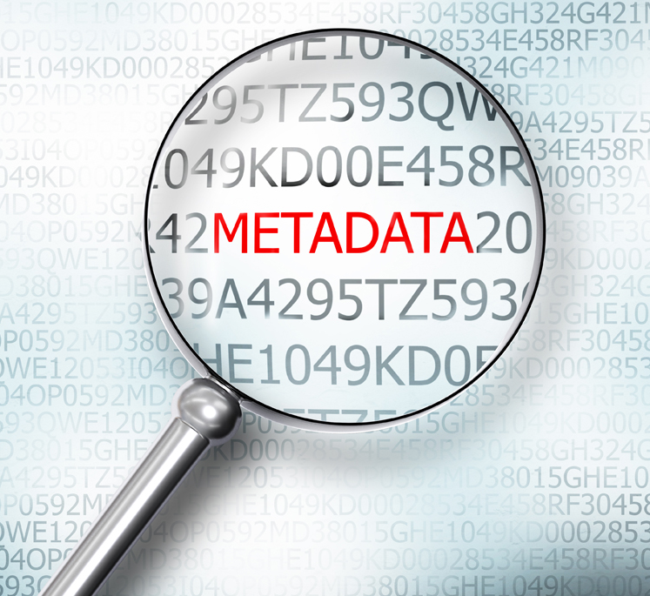
Attribute Metadata
For numerical attributes, metadata can be:
Minimum
Maximum
Mean
Median
Mode
Standard Deviation
% Missing
Availability
# of distinct values
For nominal attributes, metadata can be:
Mode
% Missing
Availability
# of distinct values
For ordinal attributes, metadata will include all from nominal attributes plus:
Order
Traditionally metadata has been understood as “Data about data”
Corporate Presentation Template | © 2016, Abzooba India Infotech Pvt. Ltd.

Slide 10
Characteristics of Structured Data
Dimensionality
Curse of Dimensionality - arises when analysing and organizing data in high-dimensional spaces
If n = no. of rows, f = no. of features then optimally n (desired) = 6f (at least)
Sparsity
Only presence counts
Dealing with missing values
Resolution
Patterns depend on the scale
Outliers
Observation point that is distant from other observations
Integrity
when merging data from heterogeneous sources, duplicates, or almost duplicate records/features may be introduced
Corporate Presentation Template | © 2016, Abzooba India Infotech Pvt. Ltd.

Slide 11
Introduction to Pandas / Numpy
“pandas” is a Python package providing fast, flexible, and expressive data structures designed to make working with “relational” or “labelled” data both easy and intuitive
One of the most useful data analysis library in Python
2 key data structures in Pandas that form the core data model:
Series : one dimensional labelled / indexed array
DataFrames : two-dimensional size-mutable, potentially heterogeneous tabular data structure with labelled axes (rows and columns)
DataFrame provides everything that R’s data.frame provides and much more
pandas is built on top of NumPy (which is the fundamental package for scientific computing with Python) and is intended to integrate well within a scientific computing environment with many other 3rd party libraries
Corporate Presentation Template | © 2016, Abzooba India Infotech Pvt. Ltd.

Slide 12
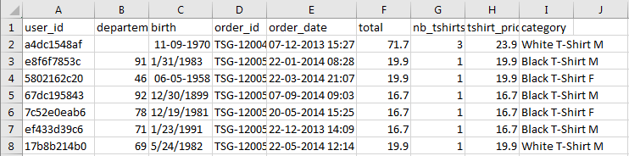
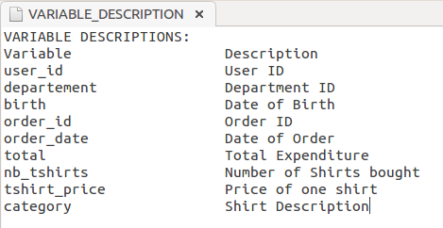
Hands on exploration of dataset
Analyse the sales data of a fictional T-shirt making company called “Haiku T-Shirt”
Used Radiant – Business analytics, an open-source platform-independent browser-based interface for business analytics in R
The application is based on the Shiny package and can be run locally or on a server.
Corporate Presentation Template | © 2016, Abzooba India Infotech Pvt. Ltd.

Slide 13
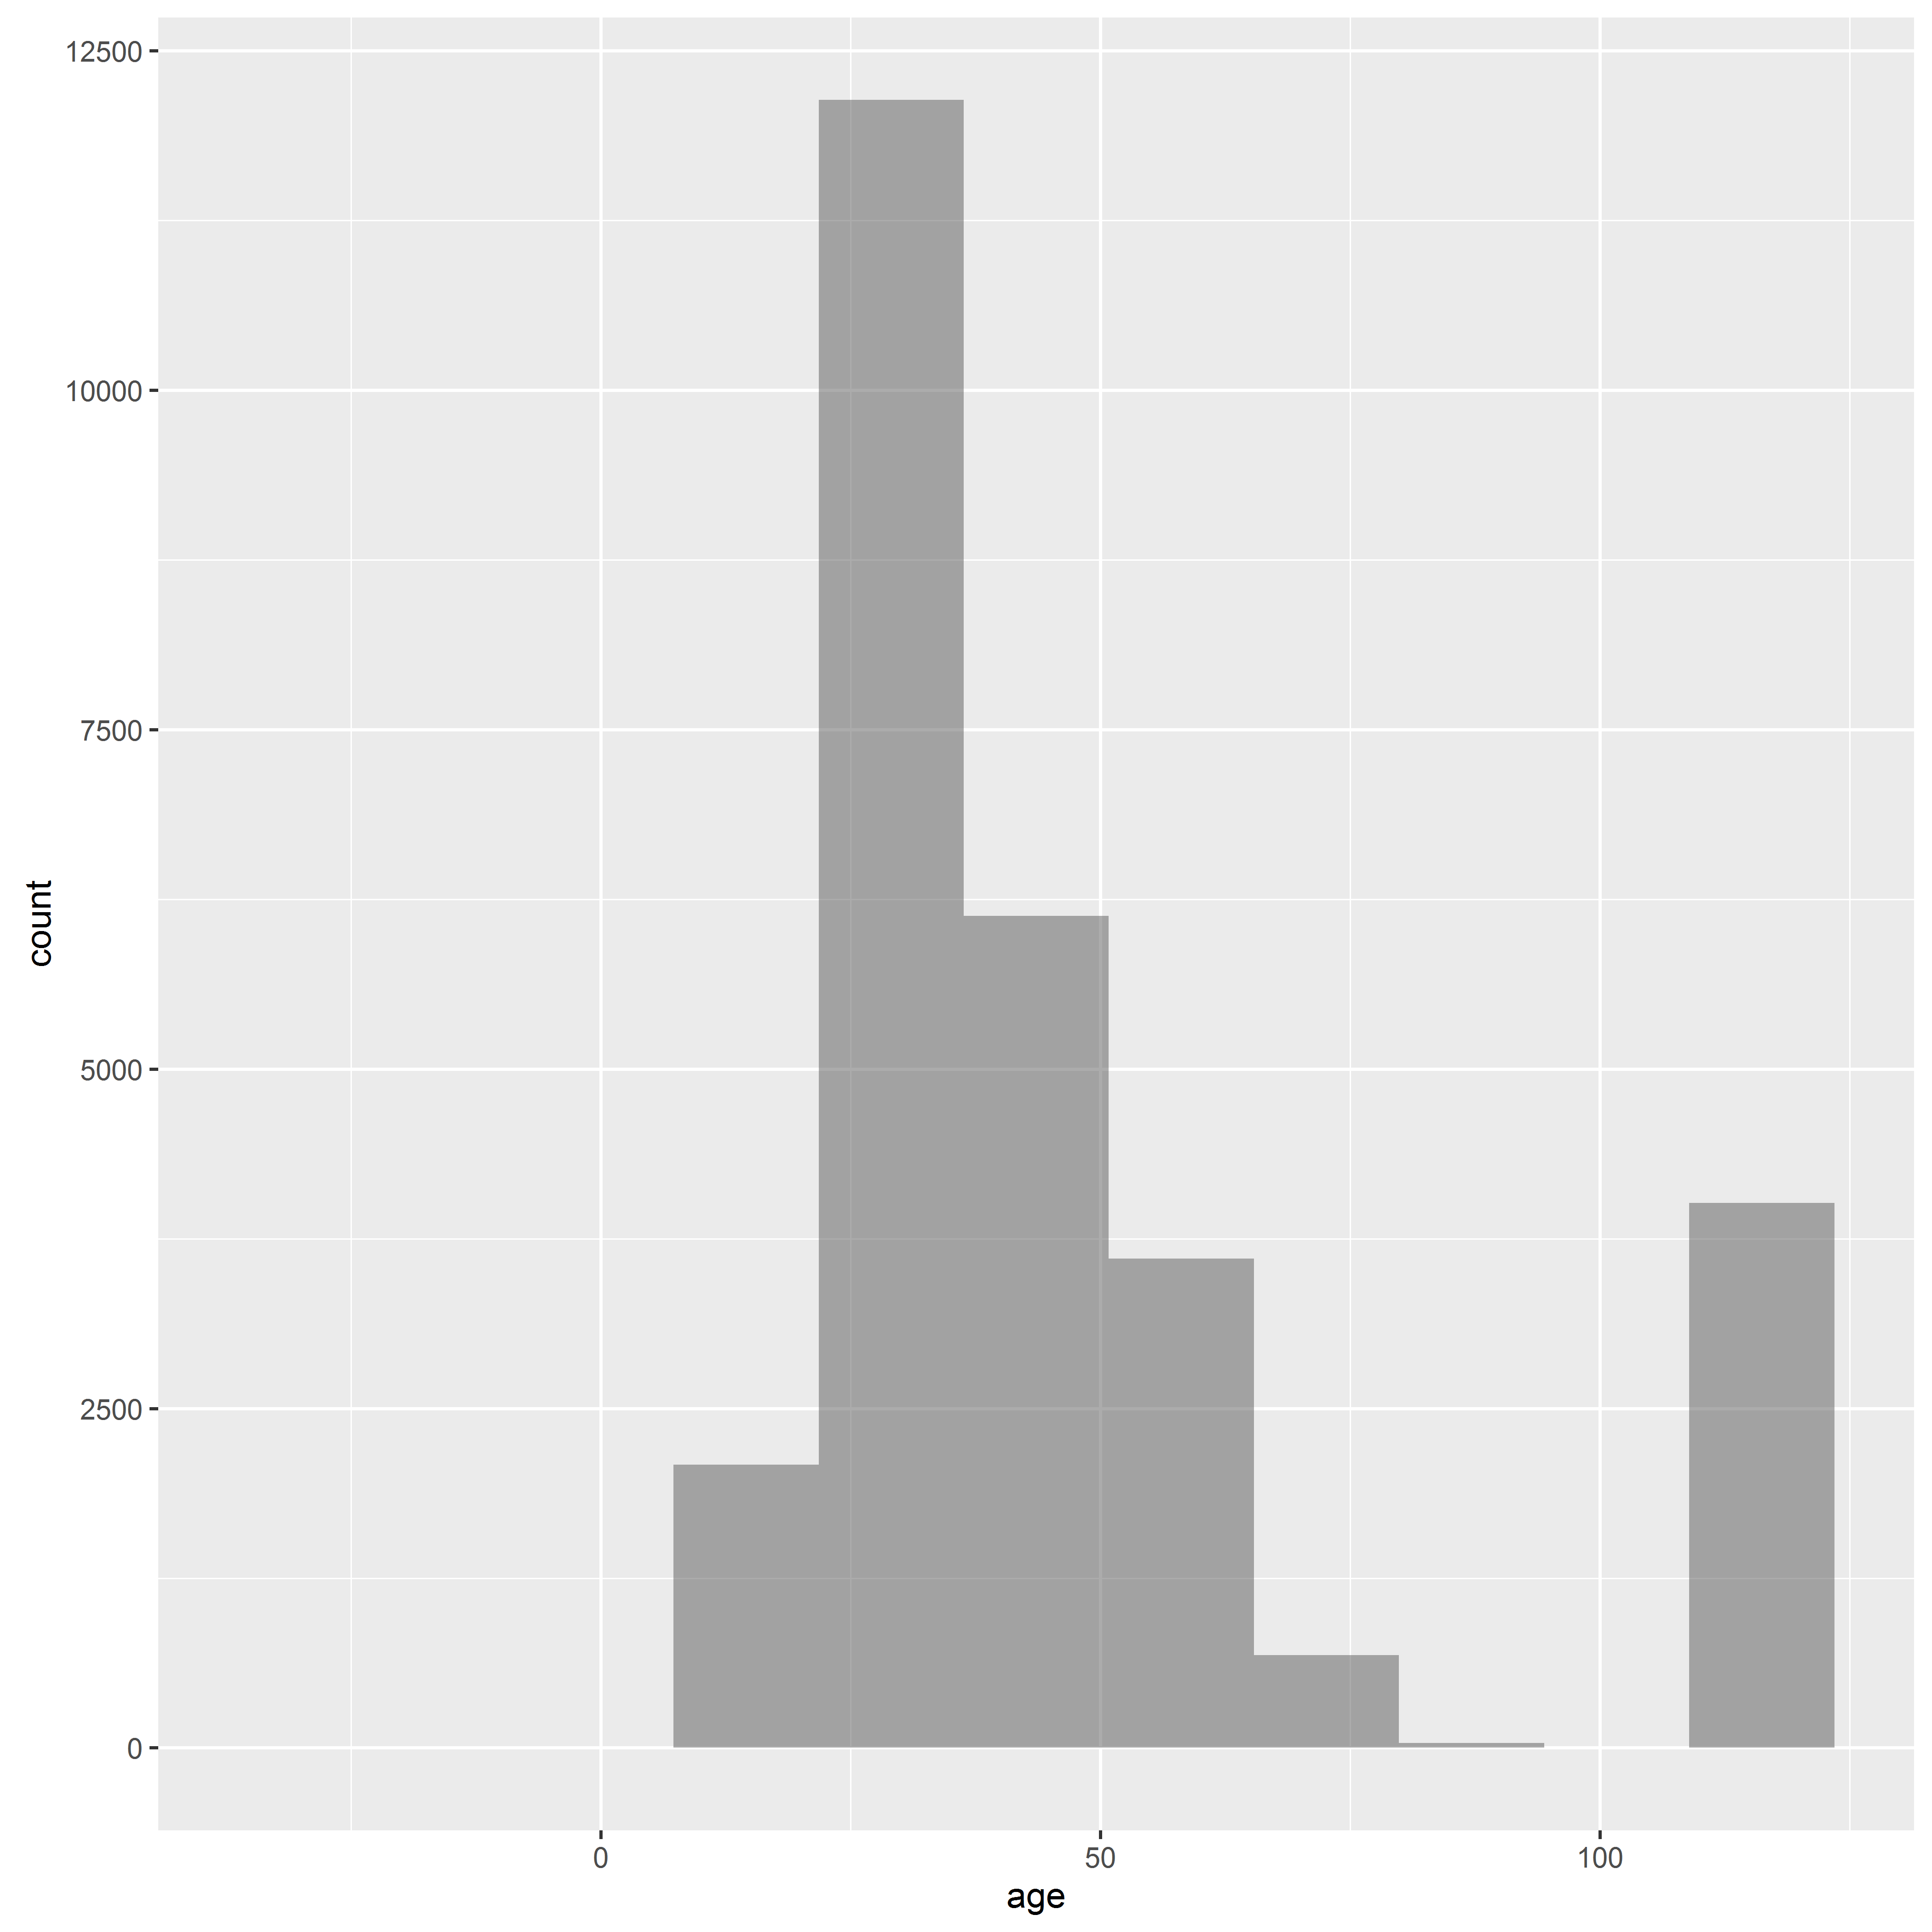
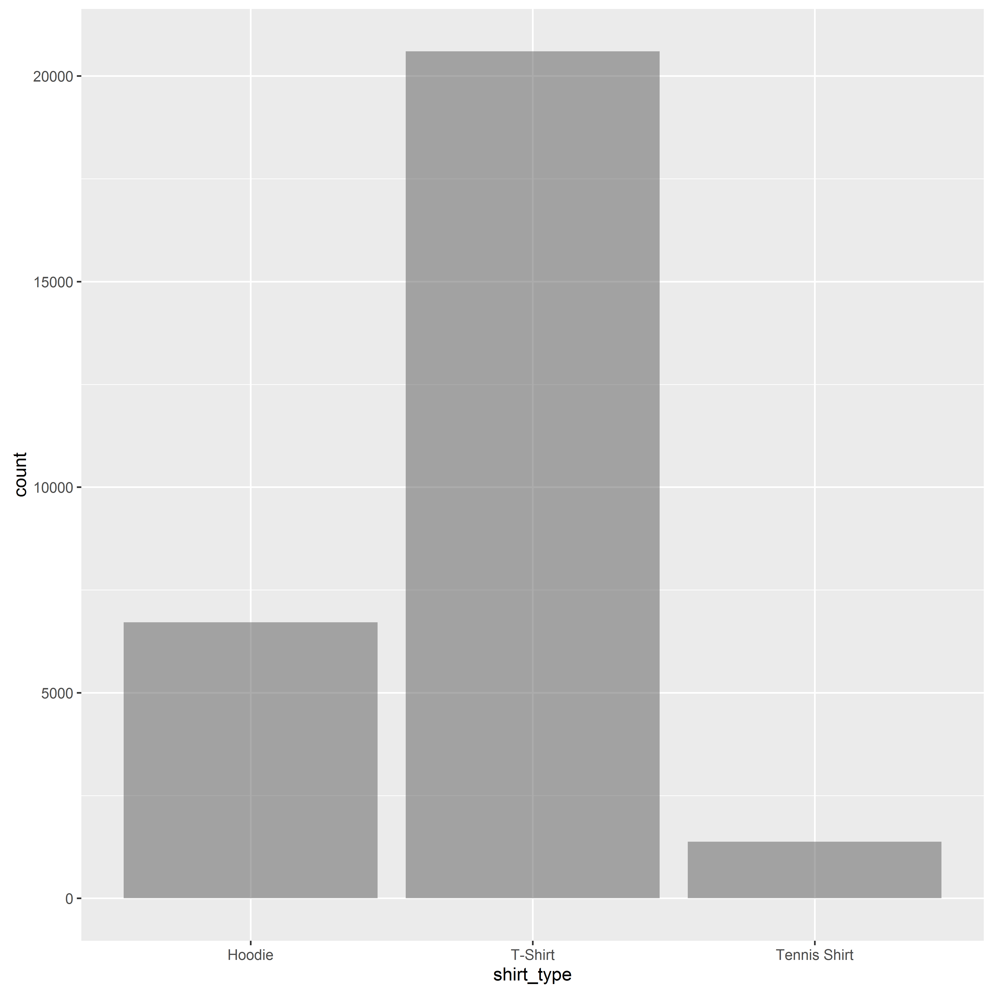
Univariate Analysis
Histograms/Distributions for continuous features
Bar plots for categorical features
Corporate Presentation Template | © 2016, Abzooba India Infotech Pvt. Ltd.

Slide 14
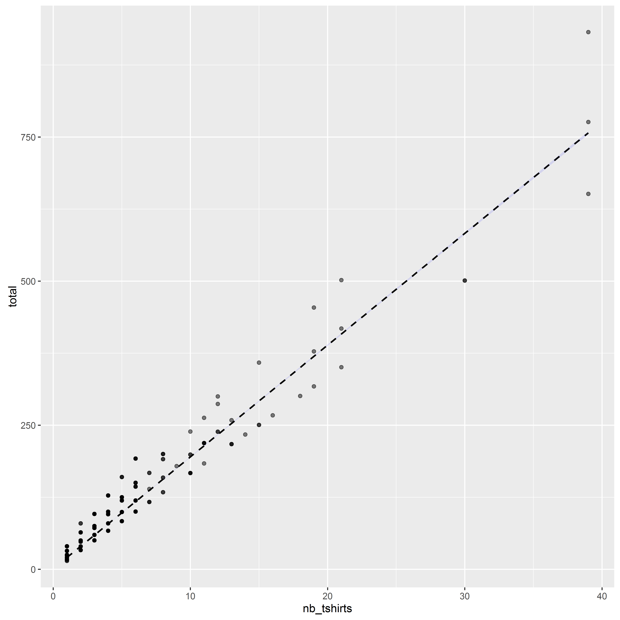
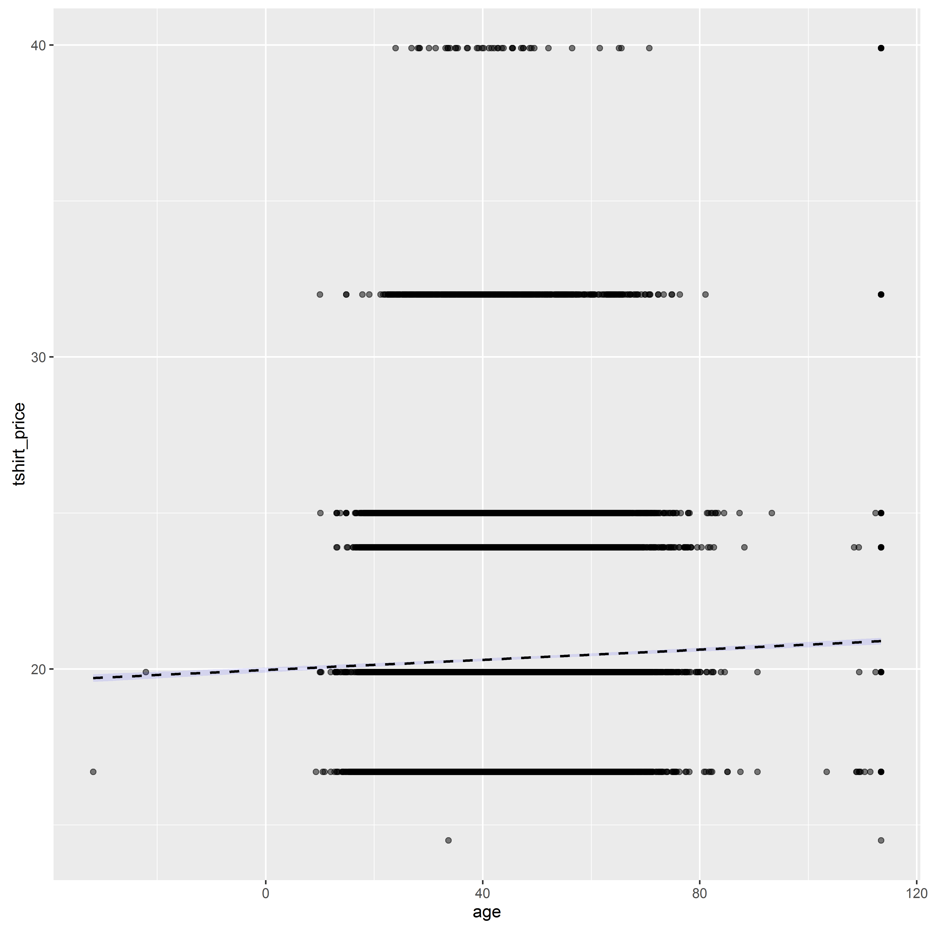
Bivariate Analysis : Numerical vs Numerical
Plots between 2 numerical variables:
Corporate Presentation Template | © 2016, Abzooba India Infotech Pvt. Ltd.

Slide 15
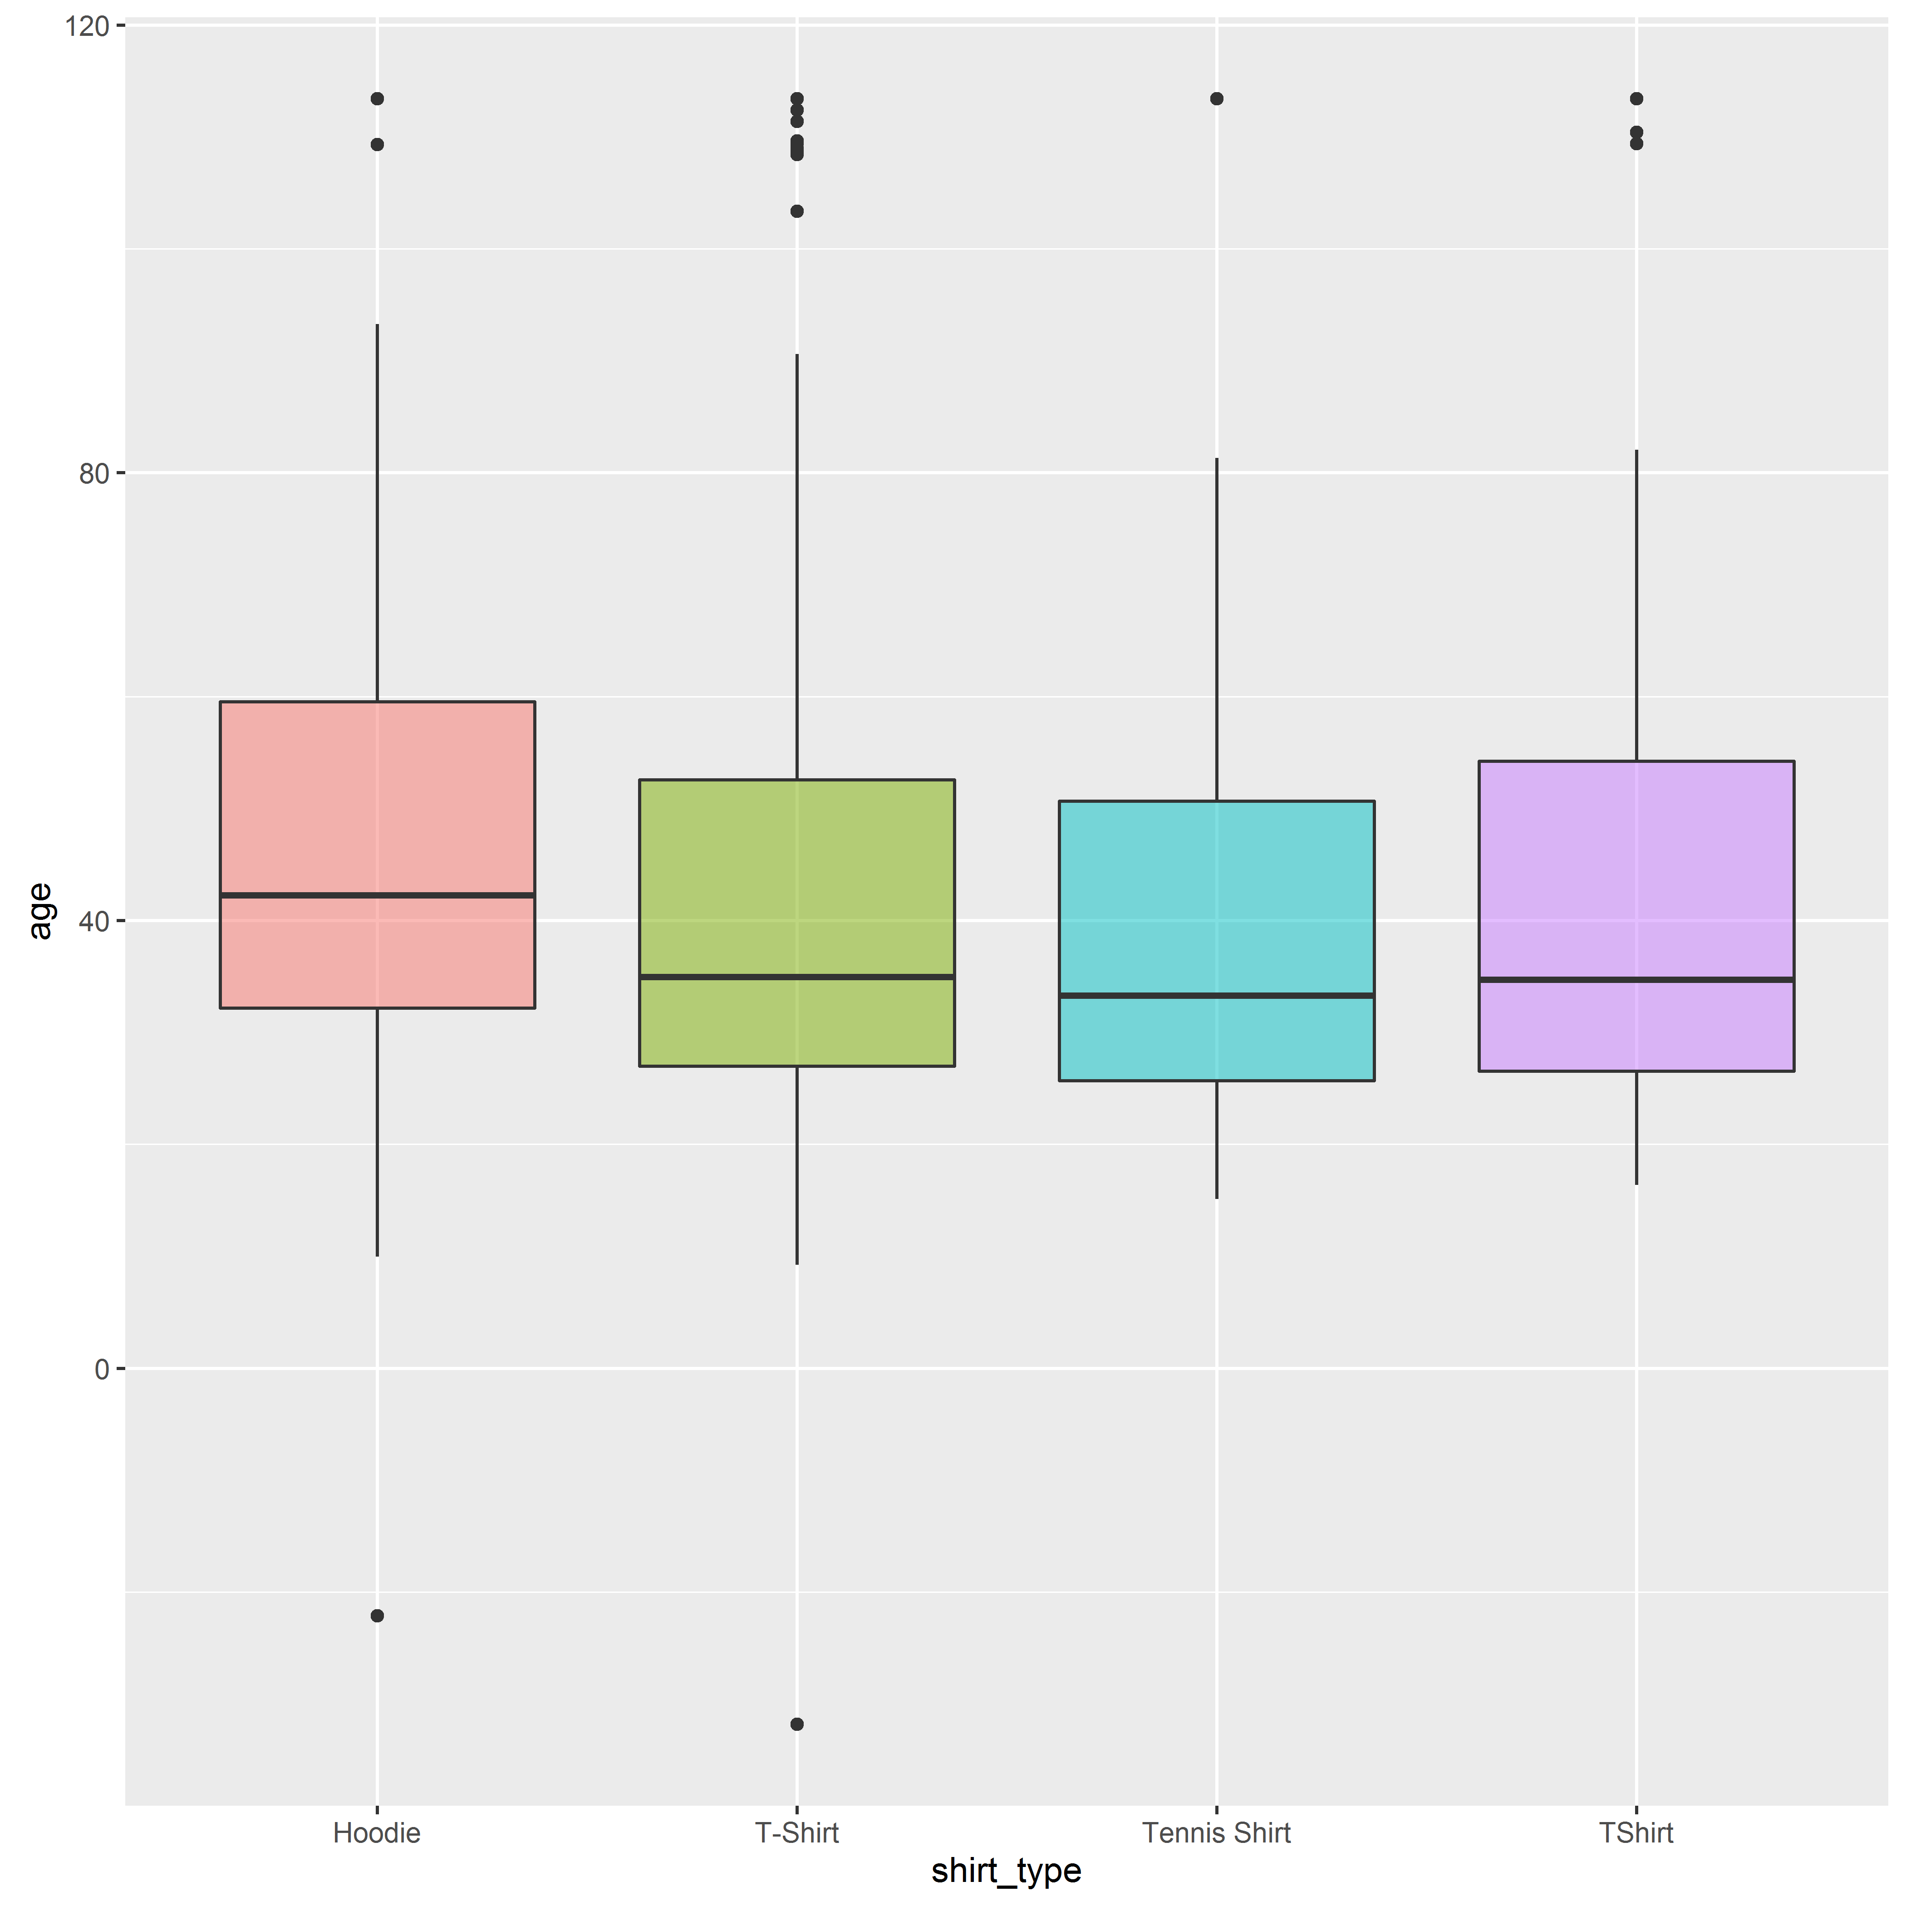
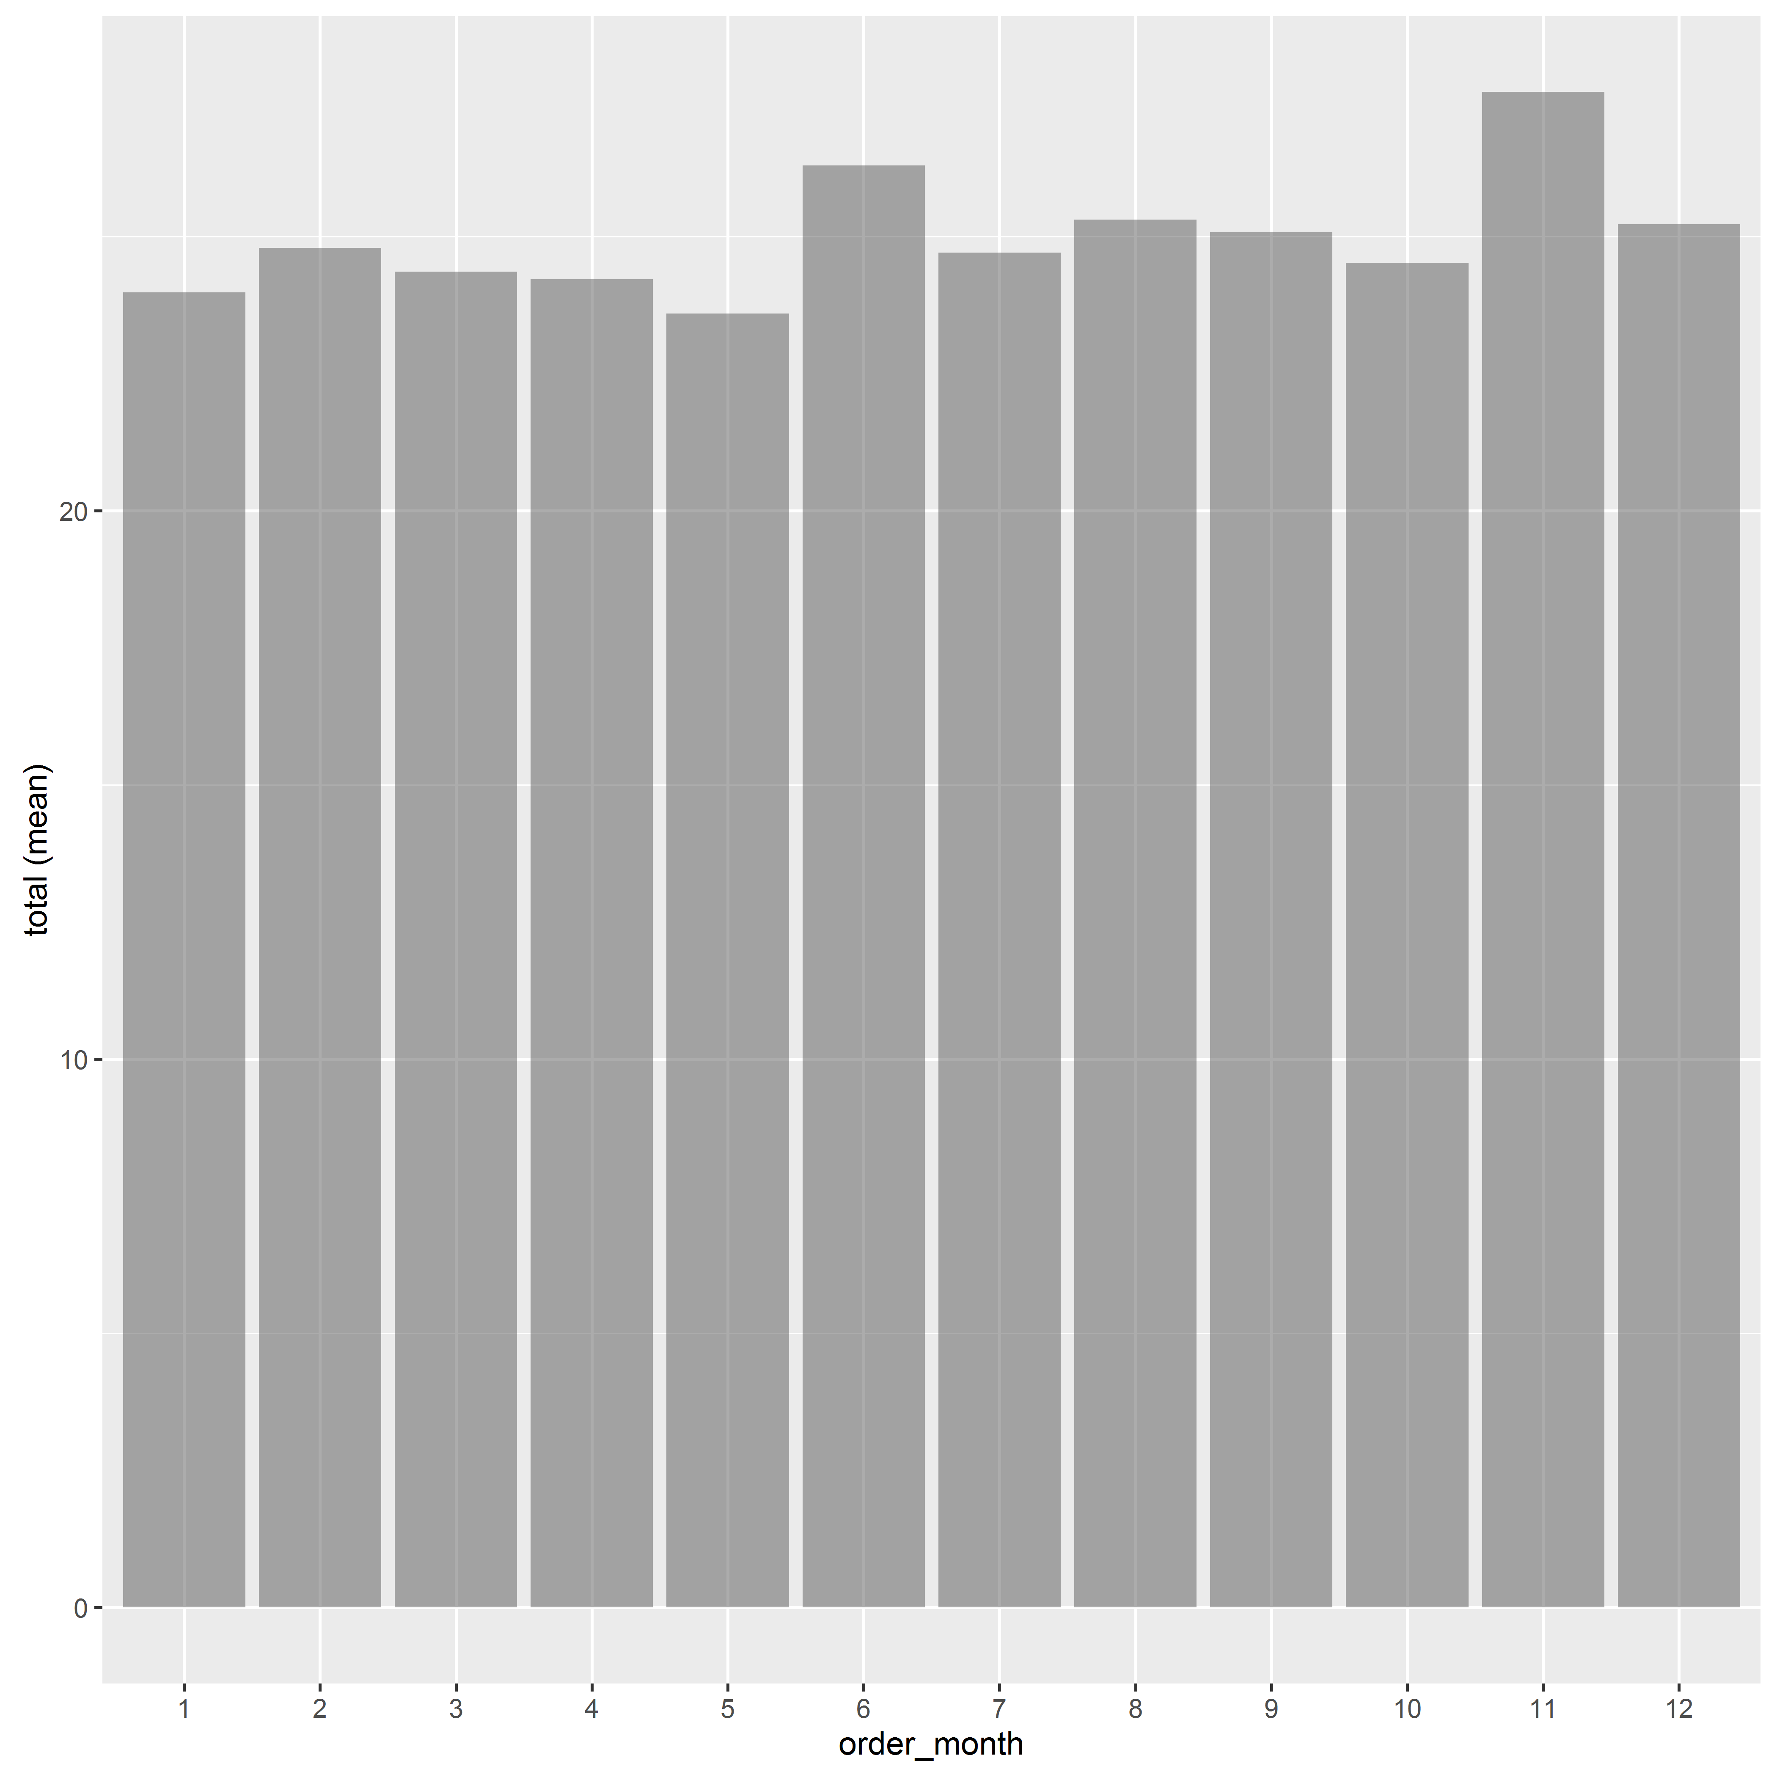
Bivariate Analysis : Numerical vs Categorical
Plots between categorical and numerical variables:
Corporate Presentation Template | © 2016, Abzooba India Infotech Pvt. Ltd.

Slide 16
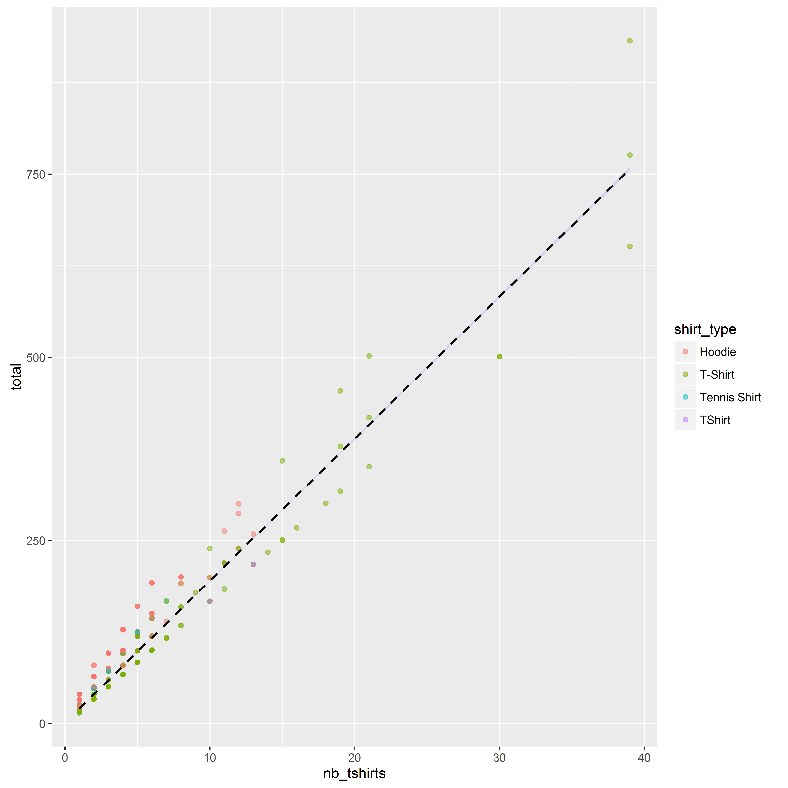
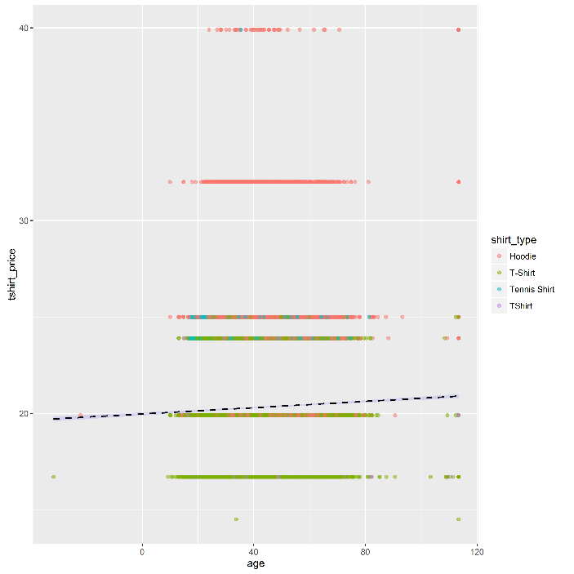
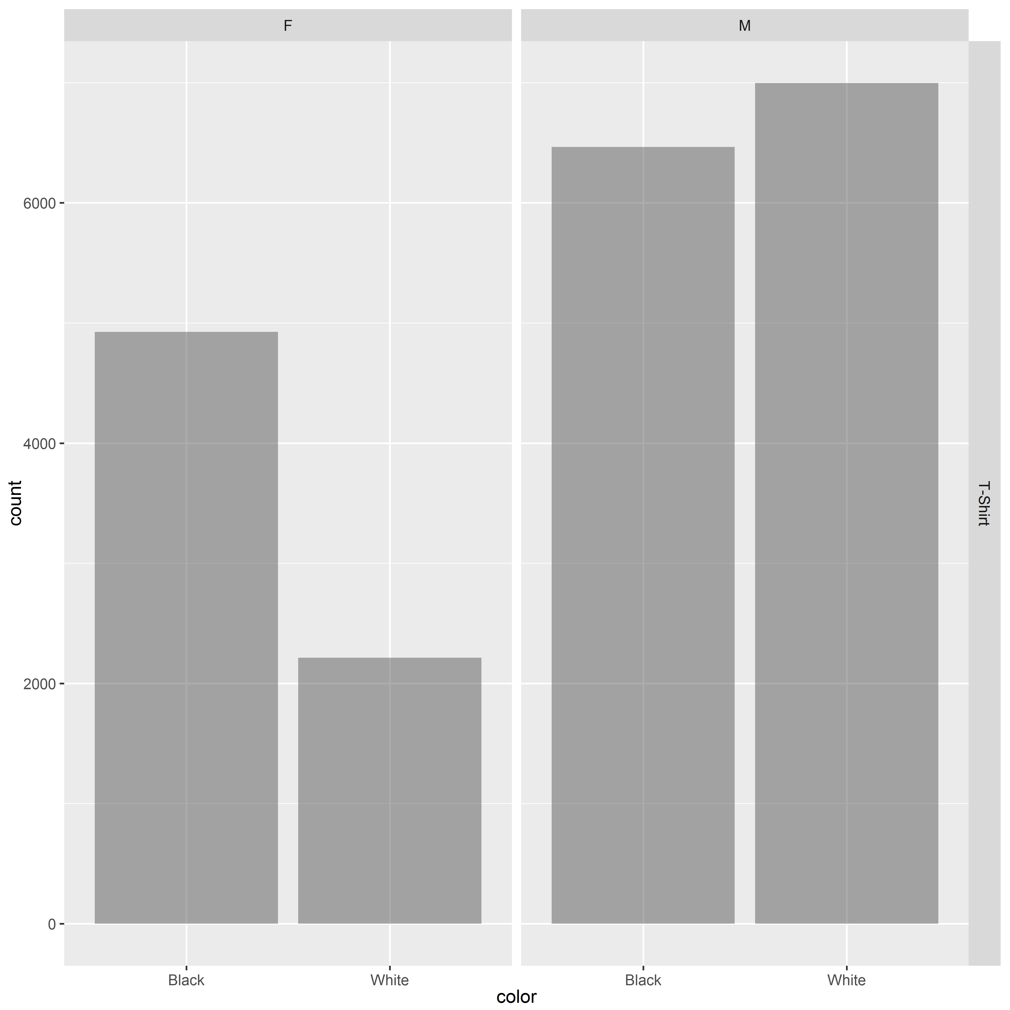
Multivariate Analysis
Plots involving multiple variables
Corporate Presentation Template | © 2016, Abzooba India Infotech Pvt. Ltd.

Slide 17
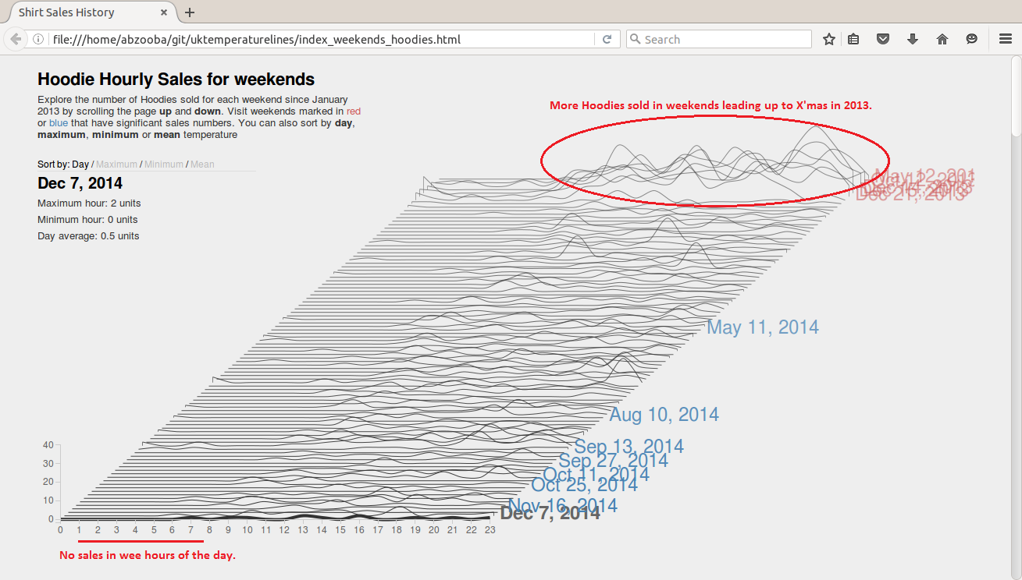
Studying Time trends
Using d3.js visualization to observe patterns in sales with time:
Corporate Presentation Template | © 2016, Abzooba India Infotech Pvt. Ltd.

Slide 18
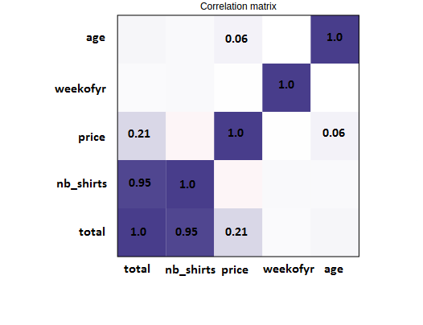
Pair wise collinearity
Examine pair wise correlations between variables and remove one from each pair with high correlation
Use pair wise correlations to fix outliers and fill missing values
Correlation does not imply Causation. It means that there is a linear trend between x and y, but it does not mean that x causes y
Corporate Presentation Template | © 2016, Abzooba India Infotech Pvt. Ltd.

Slide 19
Resources
10 Minutes to pandas - http://pandas.pydata.org/pandas-docs/stable/10min.html
Exploratory Data Analysis with Pandas - https://www.analyticsvidhya.com/blog/2016/01/complete-tutorial-learn-data-science-python-scratch-2/
Data munging with Pandas - https://www.analyticsvidhya.com/blog/2014/09/data-munging-python-using-pandas-baby-steps-python/
Radiant – Business analytics – https://radiant-rstats.github.io/docs/index.html
D3 Gallery - https://github.com/d3/d3/wiki/Gallery
Data Source sponsored by Kaggle - https://www.kaggle.com/paulzh/tshirts
R Shiny - http://shiny.rstudio.com/
Corporate Presentation Template | © 2016, Abzooba India Infotech Pvt. Ltd.

Slide 20
Thank You
www.aidemy.org | support@aidemy.org
Corporate Presentation Template | © 2016, Abzooba India Infotech Pvt. Ltd.

